Slide 1
ZIKFreak
music studio renting service

Slide 2
Users Stories
user : someone who is potentially interested in renting a music room,
someone who stumbled upon the site
member : someone who has made an account on the site and
has registered his corresponding contact info
admin : the person(s) responsible for keeping the site up to date and accept rooms, ready to be rented.

Slide 3
Users Stories
Music room : to conform with our standard form, we need to have the following data of
any potential rental places:
Minimum required data:
1) max noise level
2) space available
3) adress
4) price / hour
5) date / hours of availability

Slide 4
Users Stories
as a user I want to:
have a search function with appropriate filters that is easy to use
have a functional map to see available rooms near a chosen location
as a member I want to:
adapt my profile so I don’t have to change the search filter again for each session
as an admin I want to:
be able to easily manage the studio’s and rooms
be able to change/delete users

Slide 5
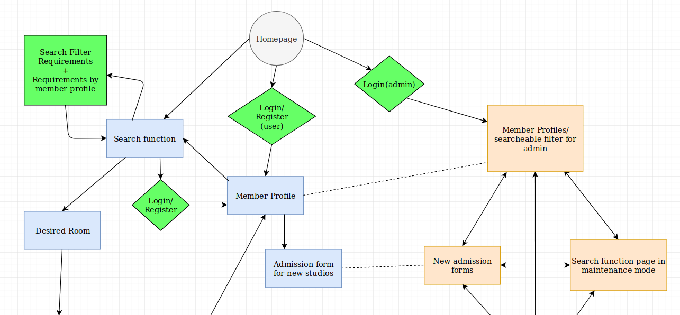
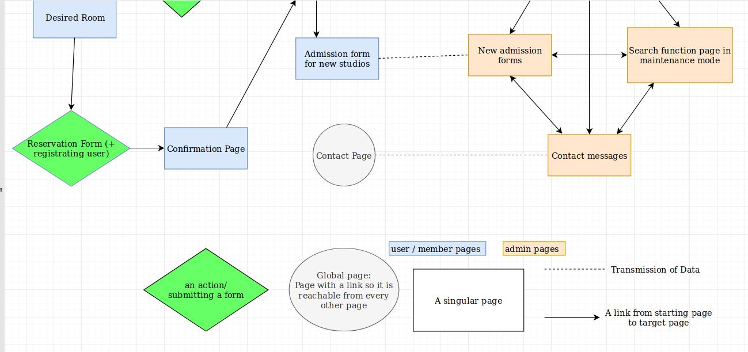

Slide 6
Wireframe

Slide 7
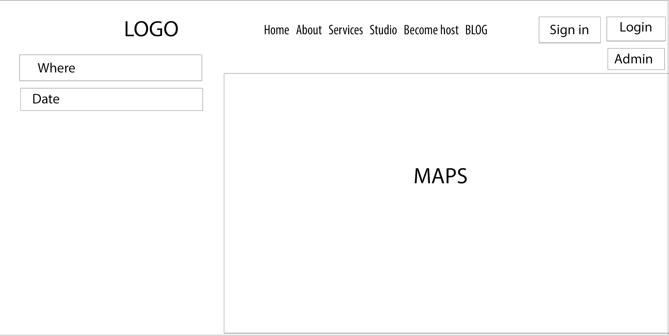

Slide 8
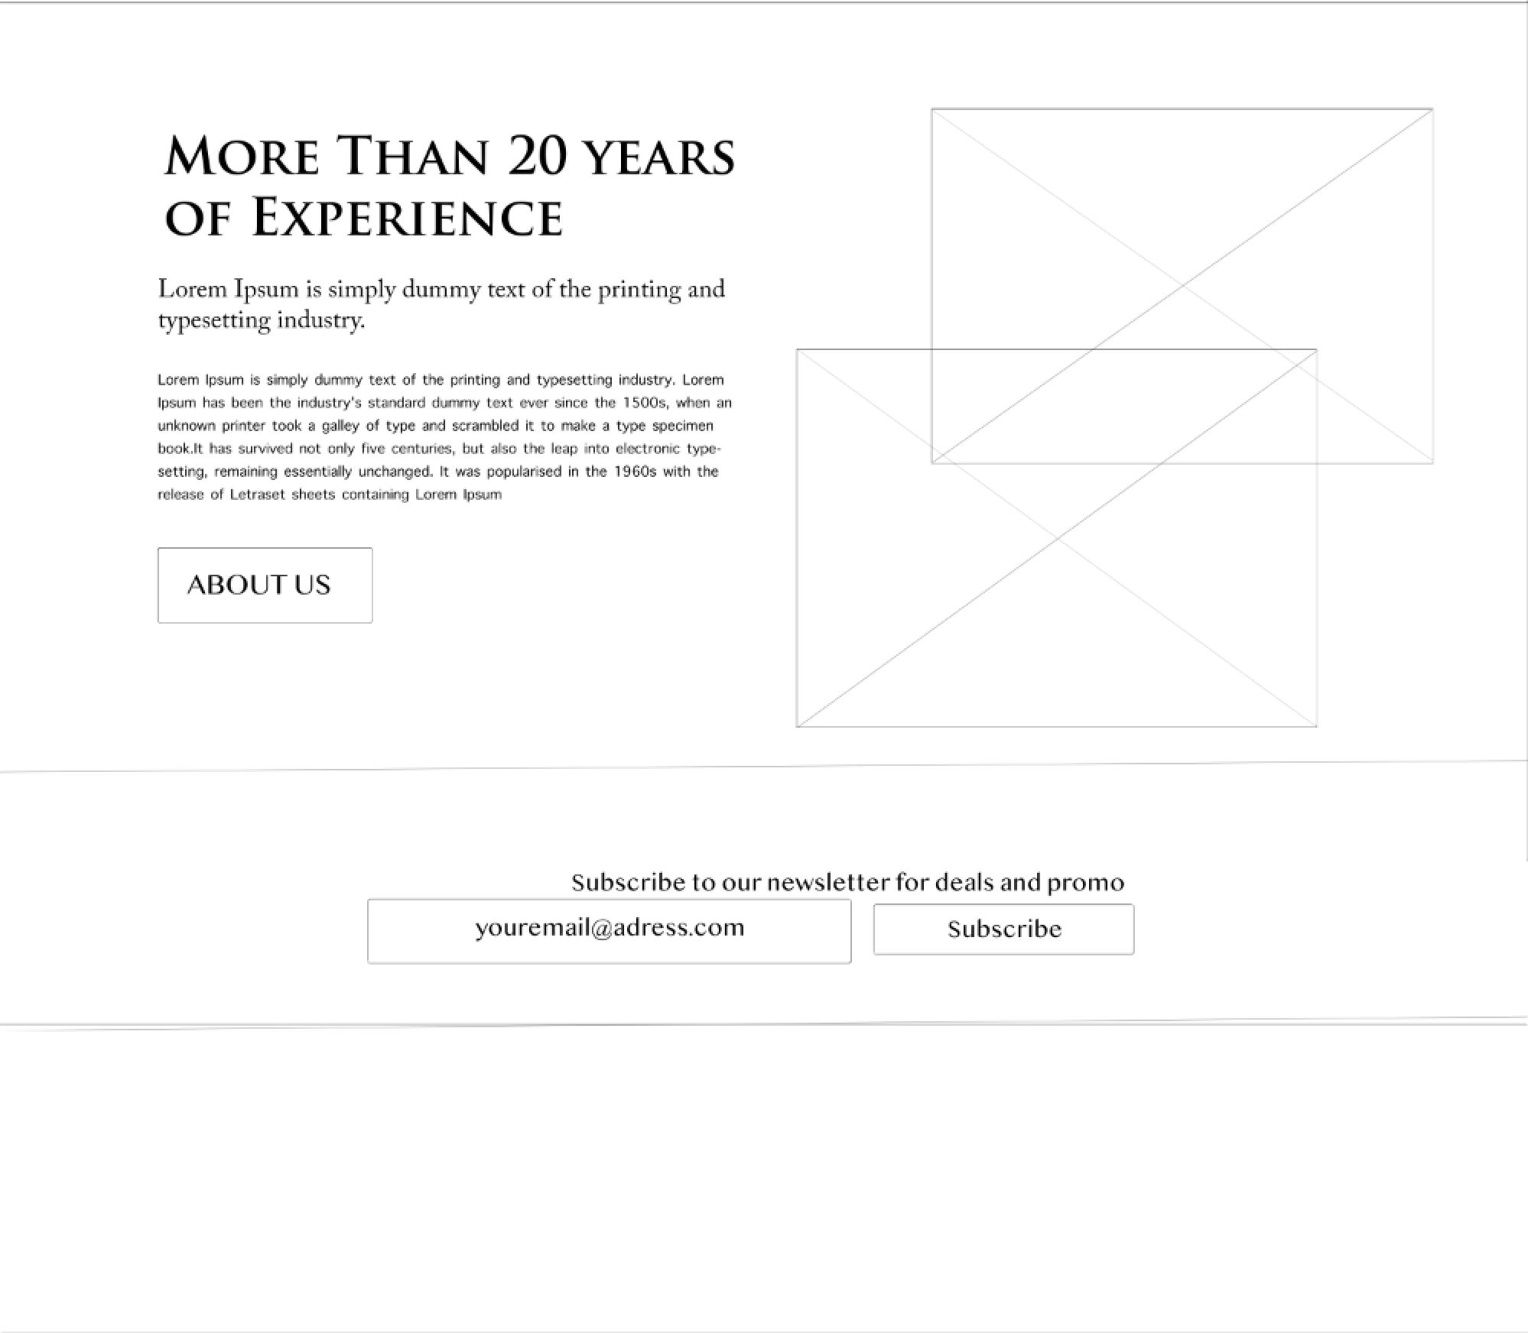

Slide 9


Slide 10


Slide 11
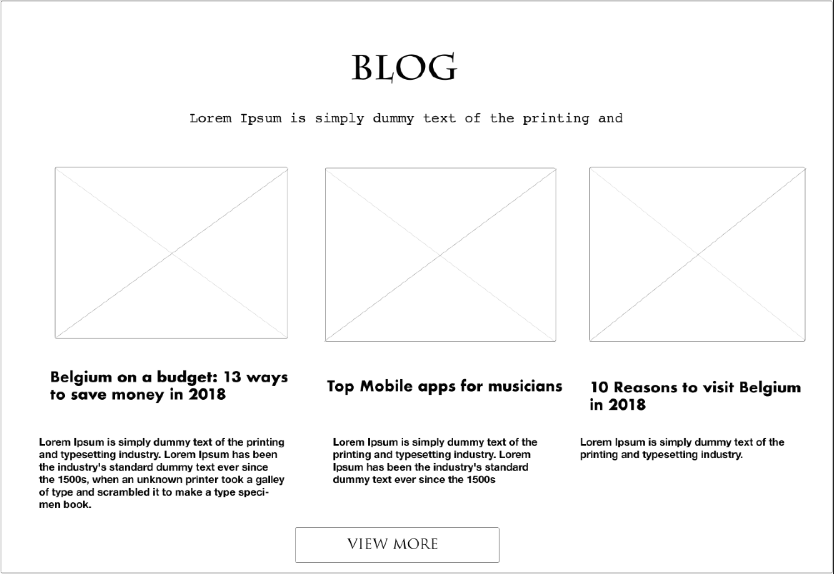

Slide 12
